Slide 1









Analysis stance
1. Analytical Policy
In anticipation of the development of optimization, consider which data groups should be emphasized.
Modeling with operational optimization in mind
Formulation for operation planning optimization
Constraints and costs that need to be considered in operation are defined as formulas.
Expressing the input-output relationship of equipment as a characteristic formula
Calculate the lowest cost operation plan within constraint conditions
Disturbance
$$y[t]$$
$$L≤ "Quality" ≤U$$
: Comply with the water quality.
Identify disturbances
$$Cost = f (operation amount)$$
: Reduce operating costs
Expressing the input-output relationship of equipment as a characteristic formula
Time t
$$x[t]$$
: Each parameters should comply with the characteristic
Reduce operating costs
$$z=g(x,y)$$
Input/Manipulated
parameter
Output quality
Time t
System
$$z[t]$$
quality
$$z[t]$$
Data-driven highlighted
Comply with demand and quality required
$$x[t]$$
Disturbance
$$y[t]$$
Time t

Slide 2
Objective of RO Optimization
1. Analytical Policy
Within the range of maintaining water quality and flow rate, operating costs are minimized considering RO membrane Condition.
Maintaining high recovery rate, good water quality (high salt rejection), and extending RO membrane life
Disinfection/ NaClO
Oxidation/
UV radiation with Chemical
Clogging Prevention/ Anti-Scalant
UF
RO
UV／AOP
Potable Water
Chemical costs
Chemical costs
Membrane cleaning costs
Electricity costs
Water quality and flow rate to be maintained
Clogging due to fouling Scaling by Crystallization Fouling by deposit
Membrane replacement costs
Chemical costs
Control Carcinogens

Slide 3
RO Viewpoint for Analysis
1. Analytical Policy
What are the operating costs and the associated Control parameters and disturbances?
Control target: Anti-Scalant, etc.
Disturbances: inflow water quality, etc.
What are the constraints (parameter to be monitored) to be observed in operation?
Monitoring parameters: Final water quality, supply flow rate, etc.
What is the timescale of the operation (optimization period, data interval) ?
What mathematical model is needed to relate each variable?
Relationship between operation parameter and cost
Relationship between operation parameter, disturbance, and water quality (including RO membrane characteristics)

Slide 4
Subdivided Objective
1. Analytical Policy
The objective can be subdivided into the following three stages.
Optimization of membrane
condition fixed
（1）Operation needs to consider final water quality and supply flow rate
Reduce excessive chemical dosage to meet water demand
（2）In addition, clogging status to be considered (monitoring the clogging)
Monitoring membrane condition taking advantage of optimization
Cleaning when the clogging status reaches the criteria limit rather than periodically (reduces excessive chemical cleaning)
（3）Operation when the membrane wear-out (the life extension)
Continue operation until replacement criteria base on expecting life
(Prevent unnecessary replacement) (How continue operation and extent to the life if deterioration is severe, etc.)

Slide 5
Where to be focussing
1. Analytical Policy
Expand the control value to be considered step by step.
Fix to the actual value when optimization calculation if the value is not considered.
Membrane cleaning
UV Radiation with
H₂O₂ or NaClO
NaClO
Acid
Anti-Scalant
Potable Water
UF
RO
UV/ AOP
Degree of Clogging
Membrane life
Water quality &
flow rate required
Flow rate and quality as required
（1）Operation needs to consider final water quality and supply flow rate
（2）In addition, clogging status to be considered (monitoring the clogging)
（3）Operation when the membrane wear-out (the life extension)
Monitoring membrane status
Conditions are given

Slide 6
Objective (1): Final water quality and flow rate considered
1. Analytical Policy
Optimization: Reduce chemical costs within the balance of water quality and flow rate Pre- & Post-RO. Flow rates should be a constant. Modeling: Predict Post-RO quality and flow rate based on Pre-RO data.
Subject to be optimization target if interchangeable with RO
Membrane cleaning
UV Radiation with
H₂O₂ or NaClO
NaClO
Acid
Anti-Scalant
Potable Water
UF
RO
UV/ AOP
Degree of Clogging
Membrane life
Water quality &
flow rate required
Flow rate and quality as required
Pre-RO
Water quality and flow rate
Post-RO
Water quality and flow rate
Time
Time
Conditions are given
Predict water quality and flow rate and decide values

Slide 7
Objective (2): Clogging Status to be Considered
1. Analytical Policy
Optimization: Reduce chemical costs by cleaning based on the clogging status
Modeling: Predict clogging status based on Pre- & Post- RO
Membrane cleaning
UV Radiation with
H₂O₂ or NaClO
NaClO
Acid
Anti-Scalant
Potable Water
UF
RO
UV/ AOP
Degree of Clogging
Membrane life
Water quality &
flow rate required
Flow rate and quality as required
Differential & Transmembrane
pressure
Clogging status
ClP
What makes benefit (cost reduction, prevention of less permeability) brought by CIP strategy ?
Time
Time
Conditions are given
Determine cleaning plans while predicting the degree of blockage

Slide 8
Objective (3): RO deterioration to be considered
1. Analytical Policy
Optimization: RO replacement costs are reduced by RO life extension considered
Modeling: Predict the RO deterioration based on Pre- & Post- RO data
Membrane cleaning
UV Radiation with
H₂O₂ or NaClO
NaClO
Acid
Anti-Scalant
Potable Water
UF
RO
UV/ AOP
Degree of Clogging
Membrane life
Water quality &
flow rate required
Flow rate and quality as required
Clogging and RO life are significantly different time scale.
Conditions are given

Slide 9
Difference per Objective
1. Analytical Policy
Step up from Small to Large and Easy to Difficult
(1) 最終水質と供給量を考慮
(2) RO膜閉塞状態も考慮
(3) RO膜劣化も考慮
(1) Consider final water quality and flow rate
(2) RO Clogging Consideration
(3) RO Deterioration Consideration
Optimization effect
Small
Middle
Large
Short-term
(minutes to hours)
Mid-term
(days to months)
Long-term
(months to years)
Optimization period
Model strategy
Statistical/ Physical Models
Closer to the physical model
Closer to statistical models
Difficulty
Easy
Middle
Difficult

Slide 10
Concerns
1. Analytical Policy
Optimization model is not compatible, for example, RO deterioration cannot be expressed from hours operation data.
Since membrane state modeling itself is difficult, it may be better to proceed with the following approach
Monitoring RO membrane status
RO clogging status prediction model
RO degradation prediction model
Water Quality Prediction Model
(1) Highest priority
(2) If modeling goes well, reflect to the optimization
(3) If modeling goes well, reflect to the optimization

Slide 12
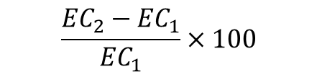


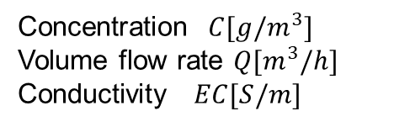



RO Membrane Performance
RO Membrane performance is measured in terms of removal rate and recovery rate.
Concentration $C[g/m^{3}]$
Volume flow rate $Q[m^{3}/h]$
Conductivity $EC[S/m]$
Supplied water
Through water
$$Q_{1},C_{1},{EC}_{1}$$
$$Q_{2},C_{2},{EC}_{2}$$
・・・
Concentrated water (drainage)
$$Q_{3},C_{3},{EC}_{3}$$
RO Membrane performance
Removal rate
LRV＝ $−\log_{10}{(\frac{C_{2}}{C_{1}})}$
Recovery rate[%]＝ $\frac{Q_{2}}{Q_{1}}×100$
Logarithmic reduction (virus removal rate)
Ionic substance removal rate
$$\frac{{EC}_{2}−{EC}_{1}}{{EC}_{1}}×100$$
What data needs to be monitored to evaluate membrane performance?

Slide 13
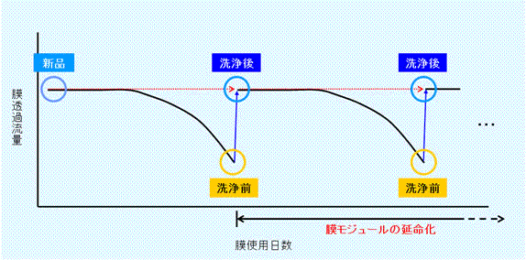
Fouling and Scaling
RO In order to maintain membrane performance, cleaning and chemical addition are required.
Fouling removal
Scale prevention
Cleaning is necessary because the recovery rate decreases with blockage.
Antiscalent NaOH
・・・
Detected by differential pressure between membranes, etc., and periodically physical cleaning (backwashing, etc.)
Pretreatment with chemicals to prevent crystal precipitation
Remove fouling with chemical cleaning
What operations are necessary to restore membrane performance and prevent deterioration?
https://www.muro-chem.co.jp/business/chemical/separation_membrane.html

